Slide 1
SMS AAWAJ
Members:-
Basant Mote - Designer
Bibek Subedi - Developer
Dinesh Subedi - Developer
Narayan Pd. Kandel - Developer
Bishnu Hari Tripati - CSO

Slide 2
Problem of VAW
Lack of Data to conduct specific program
Fear to share the problem
Difficult to conduct survey

Slide 3
How can we solve?
By collection of data
Privacy
Well format visualization

Slide 4
Solution provided by “SMS Aawaz”
How
Through SMS
Why SMS
Mobile Penetration – 66.96% whereas Smart Phone has around 20%

Slide 5
Who can use
Victim themselves
Anyone who saw the violation

Slide 6
How it help
NGO, INGO can conduct specific program to VAW
Police can investigate the problem
Anyone can see the violation data and observe the changes

Slide 7
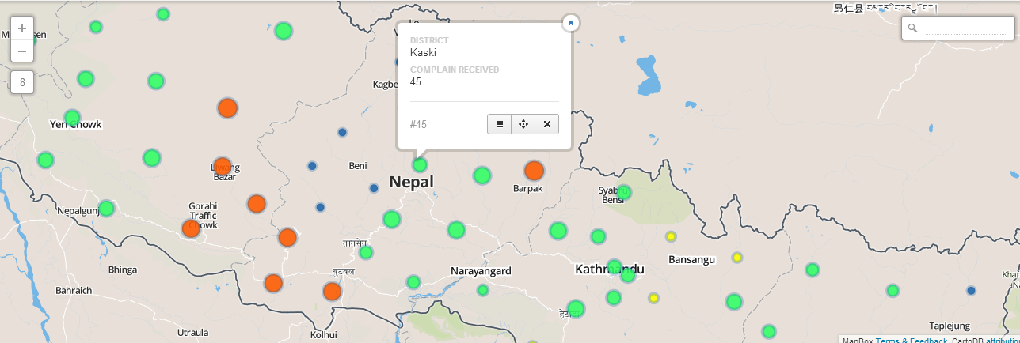
Visualization

Slide 8
